Slide 1

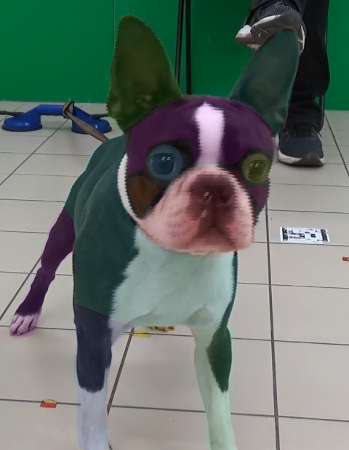
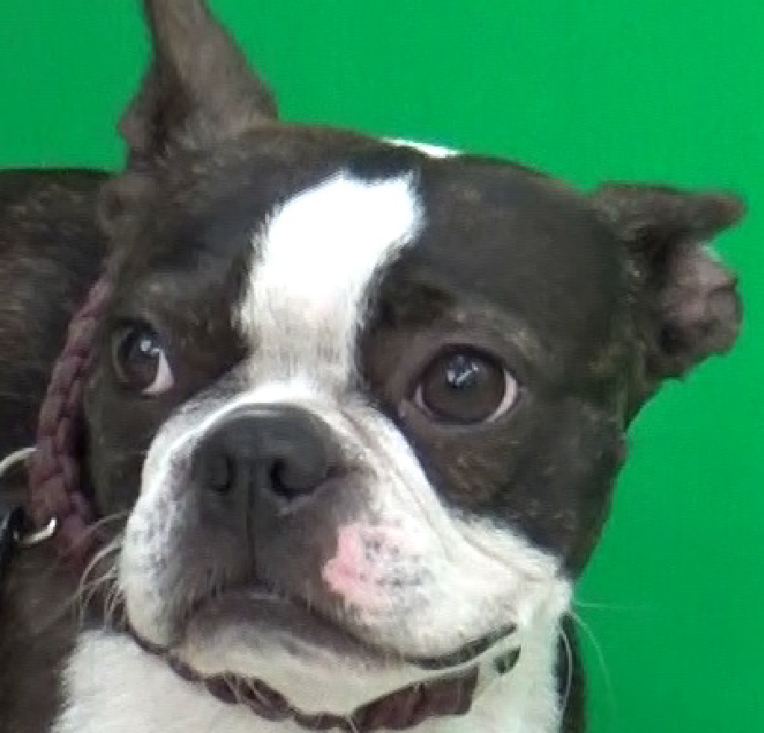
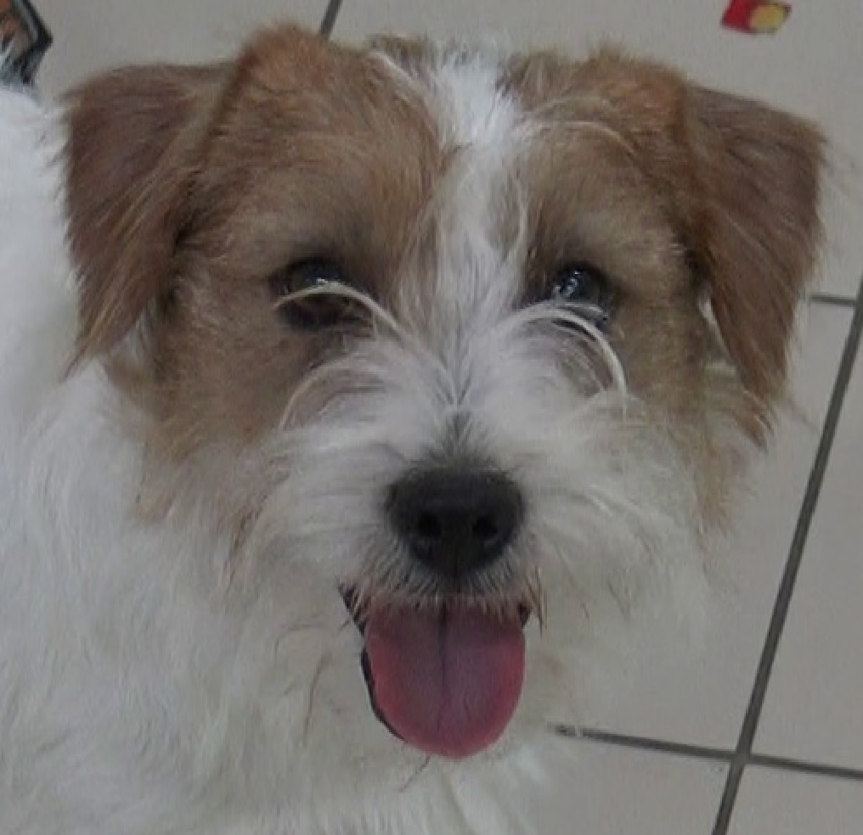
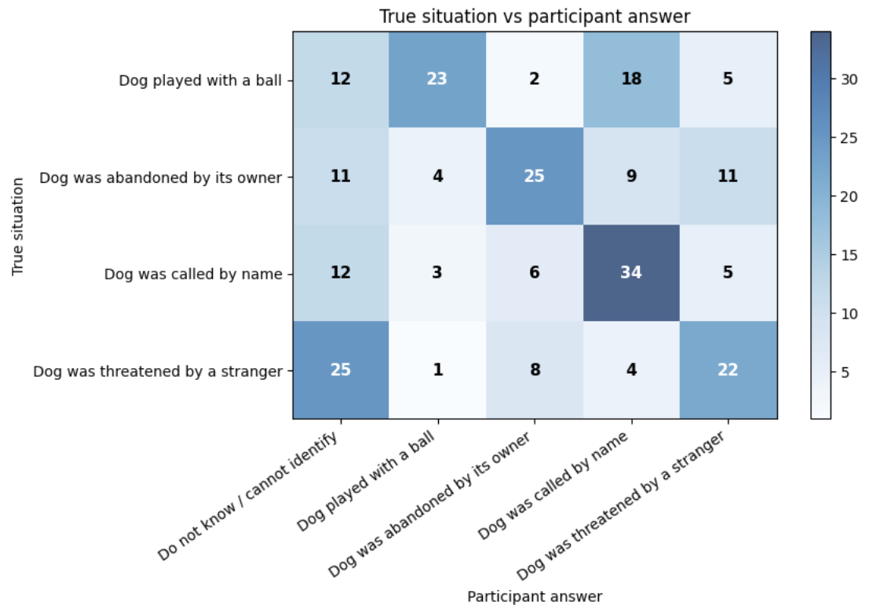
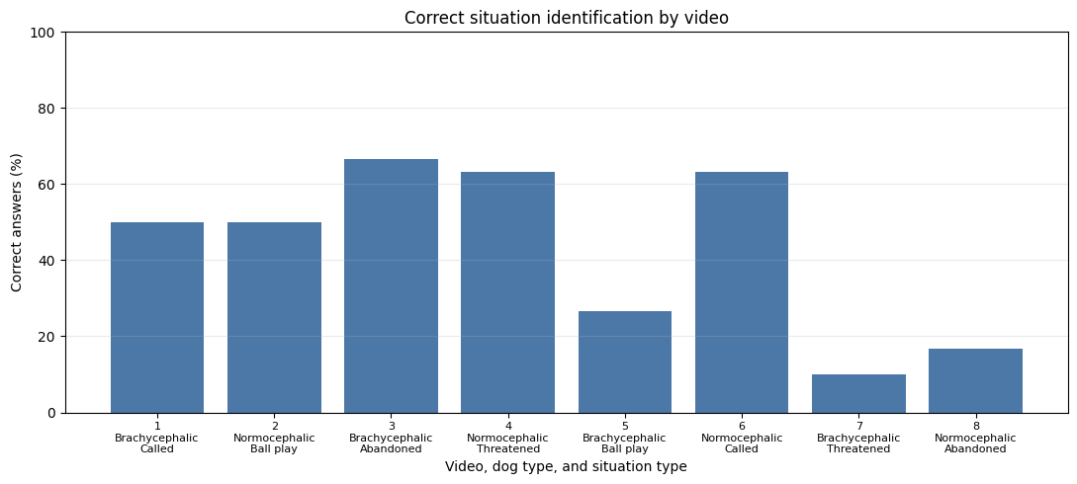
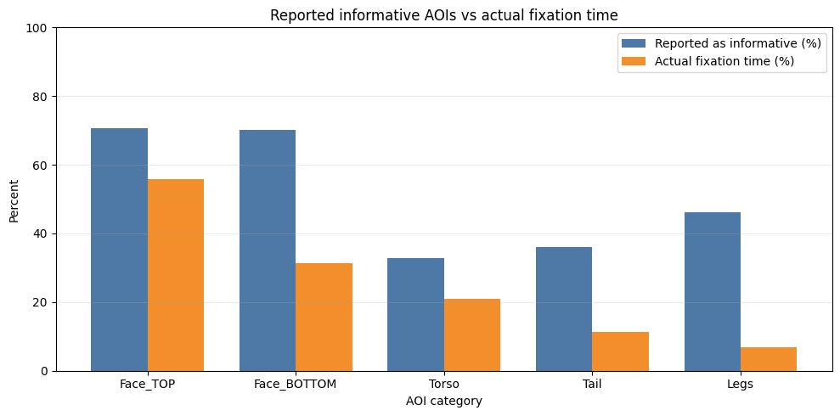
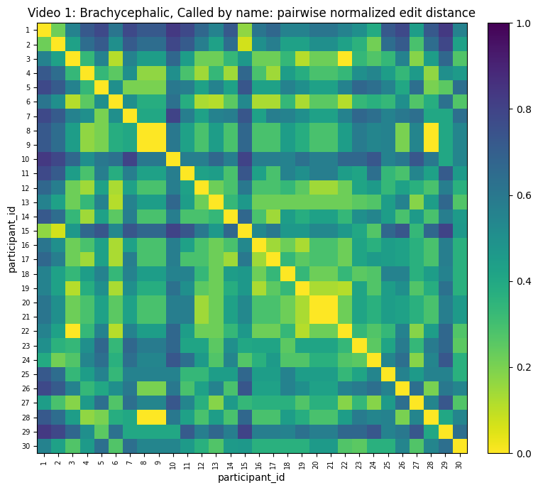
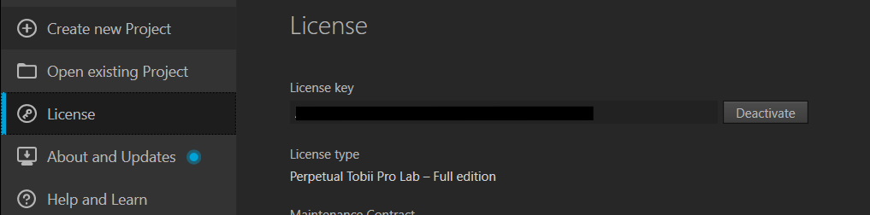
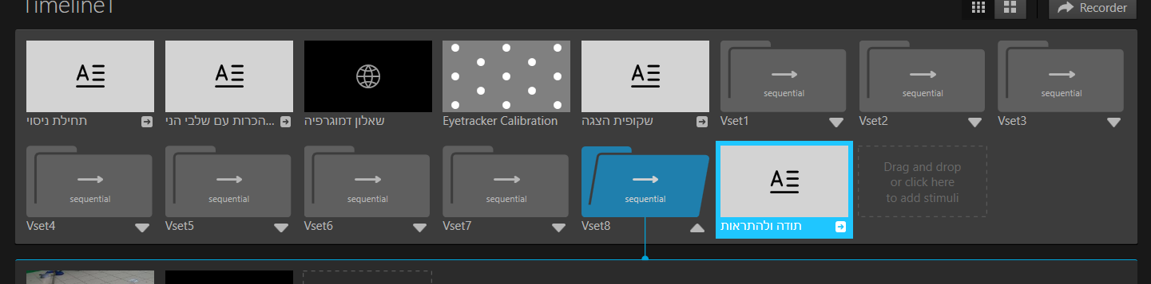
Evaluation of Human-Oriented Canine
Communication Using Eye Tracking Technology
Students
Yaniv Shtein
Eden Moshe
Supervisors
Dr. Julia Sheidin
Dr. Samah Idrees-Ghazawi
Dynamic video-based analysis of how people visually interpret dog emotions and behavior
Project code: 26-1-R-2 | Software Engineering Department
The project was part of a collaboration with a Czech research team studying human-dog communication.
PROBLEM & NEED
People often infer dog emotions from face and body language, but subjective reports do not reveal where they actually looked. Static images also miss motion, posture shifts and contextual cues. This project combines eye-tracking data with questionnaires to identify which Areas of Interest (AOIs) people visually rely on when interpreting videos of brachycephalic and normocephalic dogs.
Goal: transform raw Tobii gaze exports into normalized AOI sequences, visual metrics and interpretable findings for human-dog communication research.
RESEARCH DESIGN
TECHNOLOGIES & TOOLS
CORE REQUIREMENTS
• 30 Braude students, ages 18-35; 24 male and 6 female
• 8 dog videos: Boston Terrier and Jack Russell Terrier
• 4 situations: called by name, ball play, separation, threat
• After each video: emotion, situation and cue questions via Google Forms
• Calibration thresholds used for accuracy, precision and data loss
• Tobii Pro Spark / Tobii Pro Lab for stimulus presentation and gaze export
• Google Forms for demographic and per-video questionnaires
• Python, Google Colab, Pandas and Jupyter notebooks for cleaning and analysis
• Support an experimental workflow combining eye-tracking recordings with participant questionnaires.
• Identify where participants focused while viewing different dog behaviors and facial structures.
• Compare visual attention patterns between brachycephalic and normocephalic dogs.
• Examine whether gaze behavior was related to correct situation recognition.
• Present the collected data through clear metrics, visualizations, and comparative analyses.
From raw observations to interpretable findings
Experimental data to interpretable research findings
Recordings
Tobii gaze data
AOI Model
Findings
Data Collection
AOI Analysis
Comparisons
eye-tracking recordings
and questionnaires
+
Face_TOP • Face_BOTTOM
Torso • Tail • Legs
comparisons, accuracy
and visual summaries
Face_TOP, Face_BOTTOM,
Torso, Tail and Legs
dog type, situation
and recognition accuracy
Experimental workflow: data collection, AOI analysis and findings
Questionnaires
participant answers
Data
Data Analysis
Findings
Outputs: metrics, charts and visual summaries for the poster demonstration
gaze recordings
+ questionnaires
AOI metrics, scanpaths and recognition accuracy
comparisons, charts
KEY RESULTS
METRICS & EVIDENCE
True situation vs participant answer
30
8
48,871
3,831
AOI fixation distribution
30
8
4
2
participants
dog videos
situations
dog types
Upper face
51.3%
participants
videos
raw rows
usable AOI rows
Lower face
26.7%
Situation Recognition
Scanpath similarity
Correct identification varied substantially across videos, showing that some dog behaviors were clearer than others.
Torso
18.8%
• Highest mean similarity: Video 1, called-by-name brachycephalic dog, about 0.57.
• Lowest mean similarity: Video 2, ball-play normocephalic dog, about 0.40.
• Viewing strategy changed with movement, posture, camera angle and AOI visibility.
Legs
1.8%
Correct situation identification by video
Tail
1.4%
Interpretation
Reported informative AOIs vs actual fixation time
• Participants relied mainly on facial information, especially upper-face cues.
• Tail and legs were often reported as useful, but received very little sustained fixation time.
• Correct situation recognition was not tied to one fixed AOI; useful cues changed by video.
What the evidence shows
• Highest recognition: Video 3, brachycephalic separation, about 66.7%.
• Lowest recognition: Video 7, brachycephalic threat, about 10%.
• The same behavior was not equally clear across dog types and videos.
• Cue visibility, movement and context shaped interpretation accuracy.
These metrics are easier to explain in the poster session than raw preprocessing row counts.
DEVELOPMENT, CHALLENGES & DEMO
STUDY WORKFLOW & LESSONS LEARNED
STUDY WORKFLOW & LESSONS LEARNED
CHALLENGES & DESIGN DECISIONS
RESEARCH QUESTIONS & FINDINGS
RESEARCH QUESTIONS, FINDINGS & CHALLENGES
RESEARCH QUESTIONS & FINDINGS
The main difficulty was not only collecting gaze data, but turning noisy dynamic-video observations into defensible research evidence.
Section 5 answers the research questions; the challenge panel highlights limitations that affected interpretation.
Development workflow
Challenges and constraints
Poster demo: how the system works
1. Controlled Experiment
1. Controlled Experiment
2. Data Analysis
2. Data Analysis
3. Constraints Addressed
• Sunlight, head movement and blinking affected calibration stability.
• Participants with glasses were excluded to improve tracking reliability.
• Video AOIs were dynamic; fine facial labels had to be merged into robust categories.
• Sample was small and gender-imbalanced, so analysis remains descriptive and exploratory.
3. Constraints Addressed
Visual Attention
Recognition Accuracy
• Show the Tobii experiment timeline and AOI annotation.
• Open the cleaned dataset to explain Face_TOP, Face_BOTTOM, Torso, Tail and Legs.
• Walk through charts that compare gaze behavior with participant answers.
• Use the live notebook or prepared video if the tracker is unavailable.
Which AOIs attract the most visual attention across dog types?
Which AOIs attract the most visual attention across dog types?
How similar are participants’ gaze sequences across videos and situations?
How similar are participants’ gaze sequences across videos and situations?
Do gaze patterns differ by dog ownership or gender?
RQ1
RQ4
Do gaze patterns differ by dog ownership or gender?
Calibration Reliability
Dynamic AOIs
Self-Report Gap
Ambiguous Behavior
RQ1
Experiment
Challenges Affecting Interpretation
RQ1
RQ2
RQ2
RQ3
1
RQ3
• Participants watched eight dog videos under a fixed protocol.
• Tobii Pro Lab recorded gaze behavior during each stimulus.
• After every video, participants answered emotion, situation and cue questions.
• Participants watched eight dog videos under a fixed protocol.
• Tobii Pro Lab recorded gaze behavior during each stimulus.
• Each video was followed by emotion, situation and cue questions.
• Gaze exports were mapped into five AOIs: Face_TOP, Face_BOTTOM, Torso, Tail and Legs.
• The analysis compared fixation patterns, scanpaths and recognition accuracy.
• Questionnaire answers were used to compare reported cues with actual gaze behavior.
• Gaze exports were mapped into five AOIs: Face_TOP, Face_BOTTOM, Torso, Tail and Legs.
• Analysis compared fixation patterns, scanpaths and recognition accuracy.
• Questionnaire answers were compared with actual gaze behavior.
• Calibration quality was affected by lighting, head movement and blinking.
• Dynamic videos made fine-grained AOI labeling harder than static images.
• The sample size and gender imbalance limit the strength of conclusions.
Face_TOP received the greatest attention; Face_BOTTOM and Torso followed, while Tail and Legs were much lower.
Correct recognition was not strongly linked to one fixed AOI; useful cues changed by video.
• Calibration quality was affected by lighting, head movement and blinking.
• Dynamic videos made fine-grained AOI labeling harder than static images.
• Sample size and gender imbalance limit the strength of conclusions.
Present videos and collect gaze + questionnaire data.
Challenge
Challenge
Challenge
Challenge
Finding
Finding
Finding
Finding
Finding
Light, blinking and small head movements affected gaze quality.
Videos made fine facial regions hard to separate consistently.
Finding
Participants reported using body cues more than their fixation data showed.
Some situations were interpreted very differently across participants.
Facial AOIs received the most attention, especially Face_TOP; Face_BOTTOM and Torso followed, while Tail and Legs were much lower.
Calibration Quality
Video Variability
Facial AOIs received the most attention, especially the upper face; the bottom face and Torso followed, while Tail and Legs were much lower.
Gaze-sequence similarity varied by video. Patterns depended more on movement, situation and cue clarity than dog type alone.
Gaze-sequence similarity varied by video. Patterns depended more on movement, situation and cue clarity than dog type alone.
Dog owners and non-owners showed similar gaze transitions; gender comparison remained exploratory because the sample was imbalanced.
Lighting, blinking, head movement and glasses affected tracking reliability.
Dog owners and non-owners showed similar gaze transitions; gender comparison remained exploratory because the sample was imbalanced.
Decision
Decision
Decision
Decision
Movement, camera angle and AOI visibility changed how clear each situation was.
RQ2
Scanpaths
RQ5
Emotion Perception
Preprocess
Repositioned the setup, fixed the viewing distance, and excluded unreliable calibrations.
Merged detailed labels into broader AOIs that could support stable analysis.
Compared questionnaire answers against actual gaze distribution instead of relying on reports alone.
Treated accuracy and confusion patterns as findings, not just errors.
2
Similarity varied by video and depended on movement, situation and cue clarity more than dog type alone.
Emotion ratings depended on the combination of dog type, situation, movement and visual context.
Filter unusable rows, split face regions, resolve AOI conflicts.
Sample Limits
Exploratory Analysis
Analysis pipeline used in the project
How to present this section
Is recognition accuracy related to gaze distribution across AOIs?
How do dog type and situation affect emotional perception?
Do self-reported visual cues match actual gaze behavior?
Analysis pipeline used in the project
RQ4
RQ5
RQ6
How to present this section
Key tradeoffs that shaped the project
Why this matters
The study used 30 young adult participants and had an imbalanced gender split.
Findings are descriptive patterns, not statistically confirmed effects.
What we learned from these challenges
Good examiner questions to expect
Finding
Participant Groups
Reported vs. Actual Cues
RQ3
Collect gaze recordings
and questionnaire answers
Normalize AOIs and
remove unusable samples
Finding
Compute gaze metrics
and scanpath similarity
Explain findings with
charts and comparisons
Finding
RQ6
Start with the experiment, then show how raw gaze became AOI metrics, and finish with the constraints that shaped the analysis.
1
2
3
4
• Why split the face into top and bottom regions?
• How did calibration limits affect the final dataset?
• Why did reported cues differ from actual gaze behavior?
Is recognition accuracy related to gaze distribution across AOIs?
How do dog type and situation affect emotional perception?
Do self-reported visual cues match actual gaze behavior?
Collect gaze recordings
and questionnaire answers
Normalize AOIs and
remove unusable samples
Compute gaze metrics
and scanpath similarity
Explain findings with
charts and comparisons
Discussion angle for the poster session
RQ4
RQ5
RQ6
Start with the experiment, then show how raw gaze became AOI metrics, and finish with the constraints that shaped the analysis.
Quality
Analyze
1
Granularity
Evidence
2
3
4
Correct situation recognition was not strongly linked to one fixed AOI. Useful cues changed by video and situation.
Perceived emotion depended on the combination of dog type, situation, movement and video-specific visual cues.
Self-reported informative cues did not fully match gaze behavior: participants reported body cues, but fixations stayed mostly on facial regions.
3
Dog ownership showed no clear difference; gender comparison was limited by the imbalanced sample.
These decisions made the analysis more explainable: instead of claiming perfect emotion recognition, the project shows where visual evidence was strong, weak, or inconsistent.
These constraints explain why the findings are presented as observed patterns rather than universal claims.
Quality Over Quantity
Robust AOIs Over Fragile Detail
Reported informative cues did not fully match gaze behavior; fixations stayed mostly on facial regions.
Generate AOI proportions, transitions, scanpaths and recognition charts.
Reports Are Not Enough
This section shows that the project handled uncertainty explicitly: calibration quality, moving AOIs, and mismatch between what people said they used and where they actually looked.
fewer but cleaner gaze samples
broader AOIs over fragile labels
objective gaze plus subjective answers
Cleaner gaze samples mattered more than keeping every exported row.
Broader AOI groups made dynamic-video analysis more defensible.
Self-reported cues had to be checked against actual gaze behavior.
Finding
Finding
Finding
Correct situation recognition was not strongly linked to one fixed AOI. Useful cues changed by video and situation.
Perceived emotion depended on the combination of dog type, situation, movement and video-specific visual cues.
Self-reported informative cues did not fully match gaze behavior: participants reported body cues, but fixations stayed mostly on facial regions.
Overall: gaze focused mainly on facial regions, but interpretation changed with context, visibility, movement and uncertainty.
Main takeaway: the project is both an experimental study and a reproducible analysis workflow.
Main takeaway: the project’s value comes from handling uncertainty transparently, not hiding it.
Main takeaway: the project is both an experimental study and a reproducible analysis workflow.
Main takeaway: the project’s value comes from handling uncertainty transparently, not hiding it.
CONCLUSION
CHALLENGES & LIMITATIONS
CHALLENGES & LIMITATIONS
Eye tracking gives an objective view of how humans interpret dog emotions in dynamic video. The strongest and most consistent attention was directed toward facial regions, especially Face_TOP, but situation recognition also depended on movement, posture, dog type and cue clarity. Combining gaze data with questionnaire answers revealed a gap between what participants said was informative and where they actually looked.
Calibration Reliability
Video Variability
Sample Constraints
AOI Consistency
Calibration Reliability
Video Variability
Sample Constraints
Facial and body regions had to stay comparable across moving videos, even when angle, posture or occlusion changed what was visible.
Exploratory Analysis
Lighting, blinking, head movement and glasses affected tracking quality, so setup conditions and participant inclusion had to be controlled.
Movement, camera angle, dog position and AOI visibility made some situations clearer than others.
The study used 30 young adult participants and an imbalanced gender distribution, limiting generalization.
AOI Consistency
Lighting, blinking, head movement and glasses affected tracking quality, so setup conditions and participant inclusion had to be controlled.
Movement, camera angle, dog position and AOI visibility made some situations clearer than others.
The study used 30 young adult participants and an imbalanced gender distribution, limiting generalization.
Results describe observed patterns; no inferential tests, confidence intervals or effect sizes were applied.
FUTURE WORK
Facial and body regions had to stay comparable across moving videos, even when angle, posture or occlusion changed what was visible.
FUTURE WORK
Expand the participant pool, improve video quality and AOI visibility, add inferential statistics, and package the notebook workflow into a reproducible analysis tool for future human-animal interaction studies.
Broader Participant Sample
Next steps for strengthening the research and making the analysis more generalizable.
Recruit more diverse age groups and a more balanced gender distribution.
Richer Video Stimuli
Stronger Analysis
Add more dog breeds, situations, camera angles and repeated examples per behavior.
Apply statistical tests and predictive models to examine which gaze features explain recognition accuracy.
Sources: project report, cleaned Tobii AOI dataset, questionnaire files and user-provided poster examples.
Sources: final project report, cleaned Tobii AOI dataset, questionnaire files and user-provided poster examples.

